Slide 1

EEI4346 Web Technology Day School 05 + Practical Session 04
H.R.S.Senanayake
Email: hrsen@ou.ac.lk CITES Faculty of Engineering Technology The Open University of Sri Lanka

Slide 2

Content
Web API
Restful API
Postman API
Department of……………………………

Slide 3
Web API
Department of……………………………

Slide 4
What is Web API
Let’s watch this video first
Department of……………………………

Slide 5
What is Web API
API stands for Application Programming Interface.
A Web API is an application programming interface for the Web
The web API can be developed by using different technologies such as java, ASP.NET, etc.
Web API is used in either a web server or a web browser
If an application is to be used on a distributed system and to provide services on different devices like laptops, mobiles, etc. then web API services are used
Department of……………………………

Slide 6
Why Choose Web API?
Web API services are preferable over other services to use with a native application that does not support SOAP but requires web services.
For creating resource-oriented services, the web API services are the best to choose.
Good performance and fast development of services
For developing light weighted and maintainable web services, web API services are really helpful to develop that service. It supports any text pattern like JSON, XML, etc.
Web API services are the best for the devices that have tight bandwidth or have a limitation in bandwidth
Department of……………………………

Slide 7
Where to use Web API?
Web APIs are very useful in the implementation of RESTFUL web services using the .NET framework.
Web API helps in enabling the development of HTTP services to reach out to client entities like browsers, devices, or tablets.
ASP.NET Web API can be used with MVC for any type of application.
A web API can help you develop an ASP.NET application via AJAX.
Web API makes it easier for the developers to build an ASP.NET application that is compatible with any browser and almost any device.
Department of……………………………

Slide 8
Third-Party APIs
Third-party APIs are not built into your browser.
To use these APIs, will have to download the code from the Web.
- YouTube API allows you to display videos on a website.
- Twitter API allows you to display Tweets on a website.
- Facebook API allows you to display Facebook info on a website.
Department of……………………………

Slide 9
RESTful API
Department of……………………………

Slide 10
RESTful API
Let’s watch this video first
Department of……………………………

Slide 11
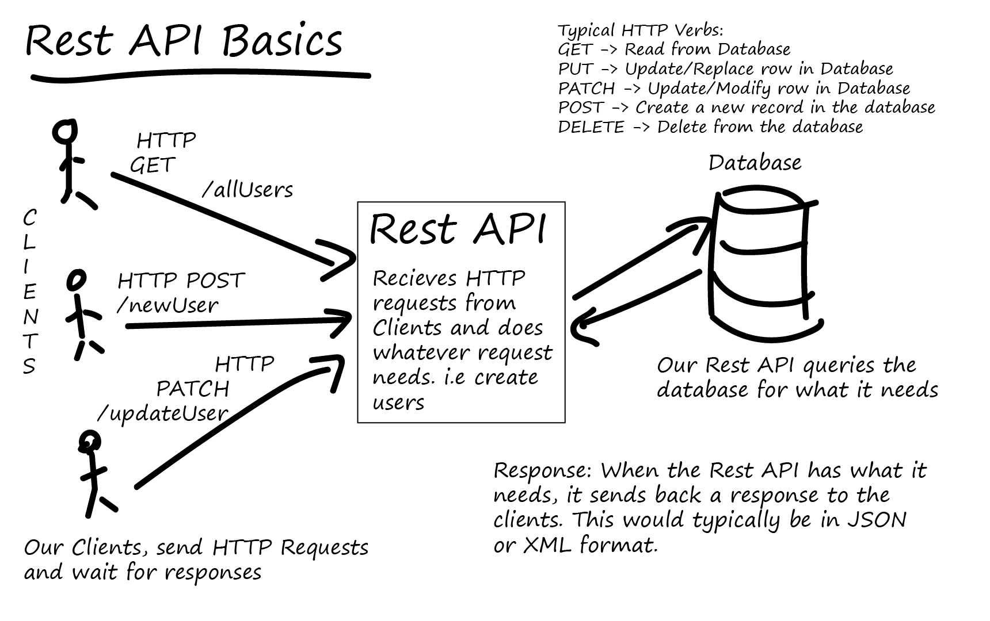
What is RESTful API?
The REST stands for REpresentational State Transfer
It is an architectural style that defines a set of rules in order to create Web Services
Department of……………………………

Slide 12
Principles of REST API
Stateless:- Each request needs to include all the information necessary for processing it.
Client-Server:- The client-server architecture enables a uniform interface and separates clients from the servers. This enhances the portability across multiple platforms as well as the scalability of the server components.
Department of……………………………

Slide 13
Principles of REST API
Uniform Interface:- To obtain the uniformity throughout the application, REST has the following four interface constraints:
Resource identification
Resource Manipulation using representations
Self-descriptive messages
Hypermedia as the engine of application state
Department of……………………………

Slide 14
Principles of REST API
Cacheable:- In order to provide a better performance, the applications are often made cacheable.
This is done by labeling the response from the server as cacheable or non-cacheable either implicitly or explicitly.
If the response is defined as cacheable, then the client cache can reuse the response data for equivalent responses in the future
Department of……………………………

Slide 15
Principles of REST API
Layered system:- The layered system architecture allows an application to be more stable by limiting component behavior.
This type of architecture helps in enhancing the application’s security as components in each layer cannot interact beyond the next immediate layer they are in
Department of……………………………

Slide 16
Principles of REST API
Code on demand:- REST APIs usually send static resources, but in certain cases, responses can also contain executable code (such as Java applets). In these cases, the code should only run on-demand.
Department of……………………………

Slide 17
How REST APIs work
REST APIs communicate via HTTP requests to perform standard database functions
A GET request to retrieve a record
A POST request to create one
A PUT request to update a record
A DELETE request to delete one
A well-designed REST API is similar to a website running in a web browser with built-in HTTP functionality
Department of……………………………

Slide 18
Methods of REST API
C
POST
Create
R
GET
Read
U
Update
PUT
D
Delete
DELETE
Department of……………………………

Slide 19
POSTMAN API
Department of……………………………

Slide 20
Introduction to Postman
Postman is a standalone software testing API (Application Programming Interface) platform to build, test, design, modify, and document APIs.
It is a simple Graphic User Interface for sending and viewing HTTP requests and responses.
The ability to make various types of HTTP requests like GET, POST, PUT, PATCH, and convert the API to code for languages like JavaScript and Python.
Department of……………………………

Slide 21
Why use Postman?
Accessibility - One can use it anywhere after installing Postman into the device by simply logging in to the account.
Use Collections - Postman allows users to build collections for their API calls. Every set can create multiple requests and subfolders. It will help to organize the test suites.
Test Development - To test checkpoints, verification of successful HTTP response status shall be added to every API- call.
Automation Testing - Tests can be performed in several repetitions or iterations by using the Collection Runner or Newman, which saves time for repeated tests.
Department of……………………………

Slide 22
Why use Postman?
Creating Environments - The design of multiple environments results in less replication of tests as one can use the same collection but for a different setting.
Debugging - To effectively debug the tests, the postman console helps to track what data is being retrieved.
Collaboration - You can import or export collections and environments to enhance the sharing of files. You may also use a direct connection to share the collections.
Continuous Integration - It can support continuous integration.
Department of……………………………

Slide 23
Postman API Installation
Postman can be downloaded for all major operating systems, including Mac, Linux, and Windows, as a native app (standalone application).
Postman is also available as a chrome extension application, but it is better to install and use the native app because the Postman chrome extension does not support all the features that the native app has.
Department of……………………………

Slide 24
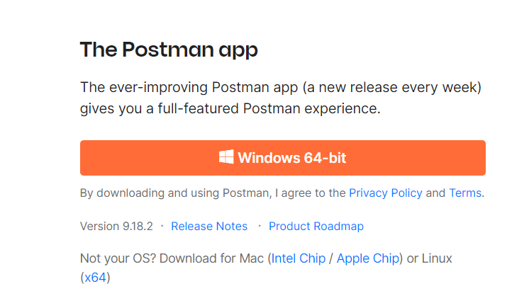
Steps to download and install
Step-1: Go to the link https://www.postman.com/downloads/ and click download for Mac or Windows or Linux based on your operating system.
Department of……………………………

Slide 25
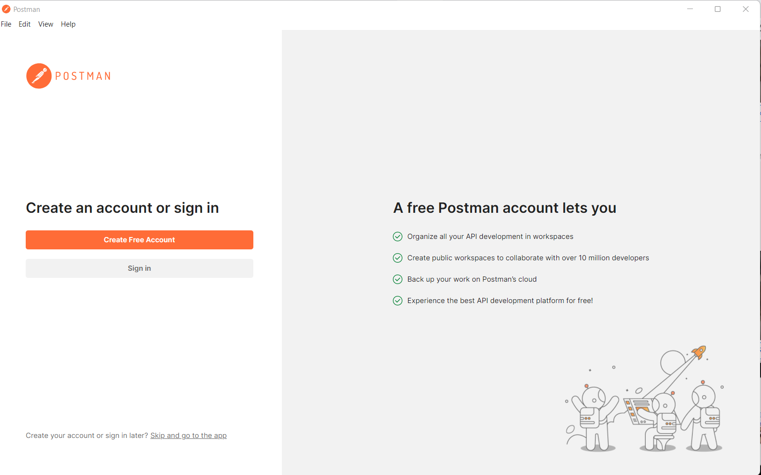
Steps to download and install
Step-2: Once the .exe file is downloaded, you need to install the application, as shown in the below image. Click on the Create free account button.
Department of……………………………

Slide 26
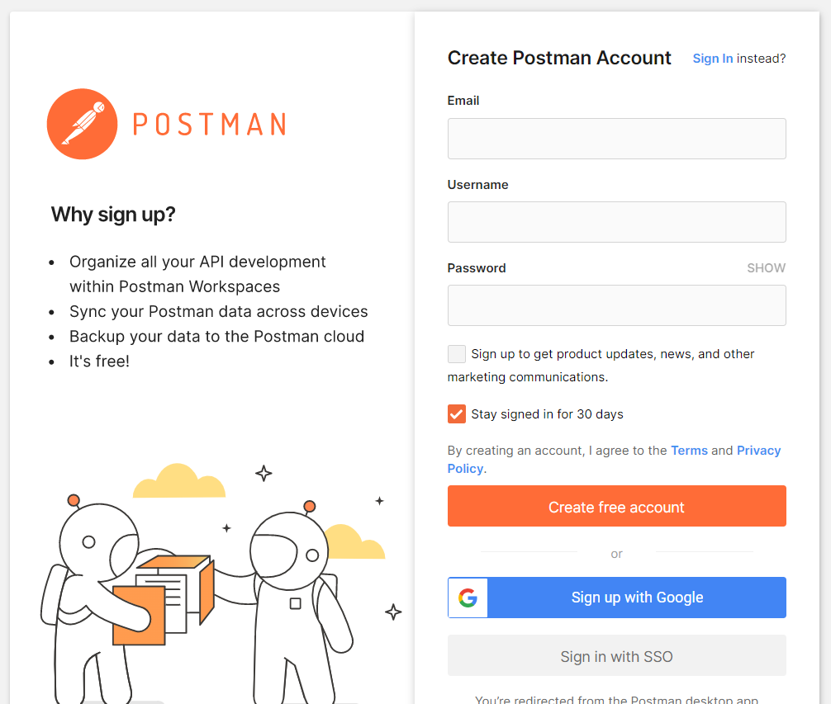
Steps to download and install
Step-3: It is better to create an account as this will help you to save the work you do within the Postman, and with this, you won't lose any work. Then you will direct to the below interface
Department of……………………………

Slide 27
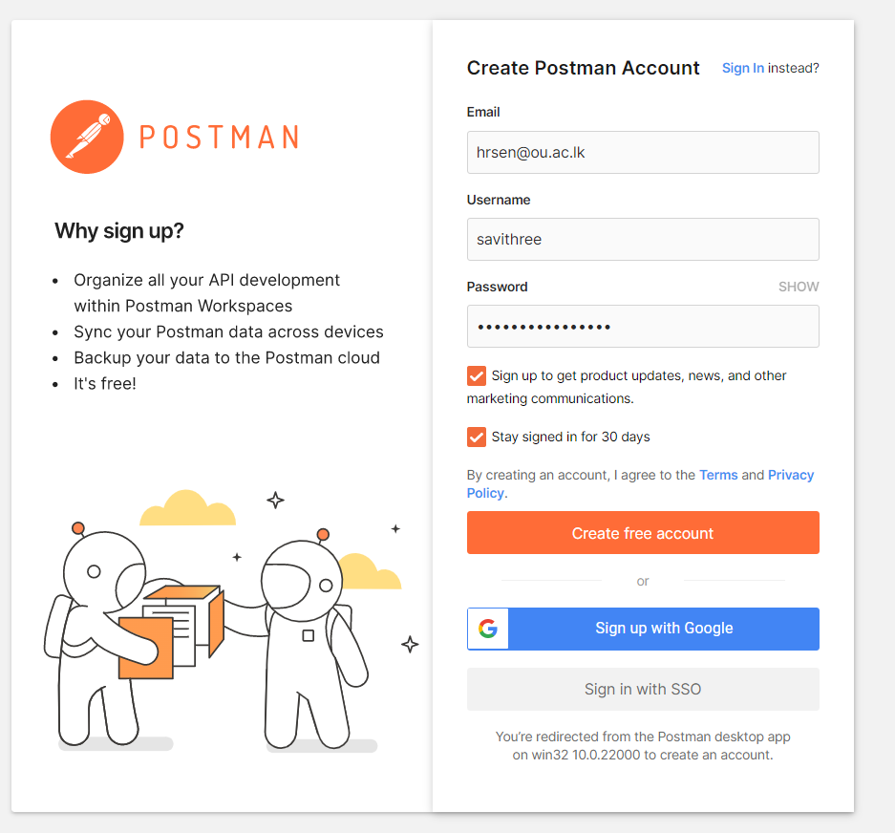
Steps to download and install
Step-4: Create your account with all the required details, or you can also signup with Google, as shown in the image.
Department of……………………………

Slide 28
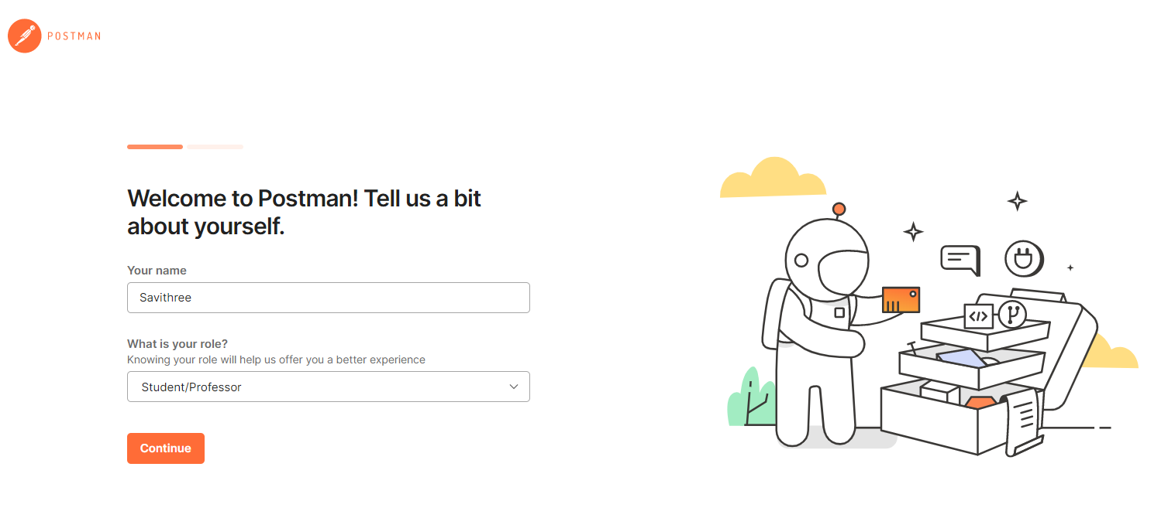
Steps to download and install
Step-5: After signing in, select the workspace tools as per your requirement, and then click on, continue to get the startup screen.
Department of……………………………

Slide 29
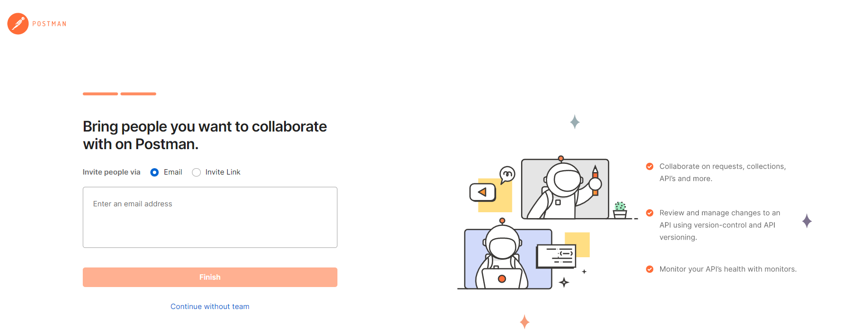
Steps to download and install
Step-6: Select continue without team.
Department of……………………………

Slide 30
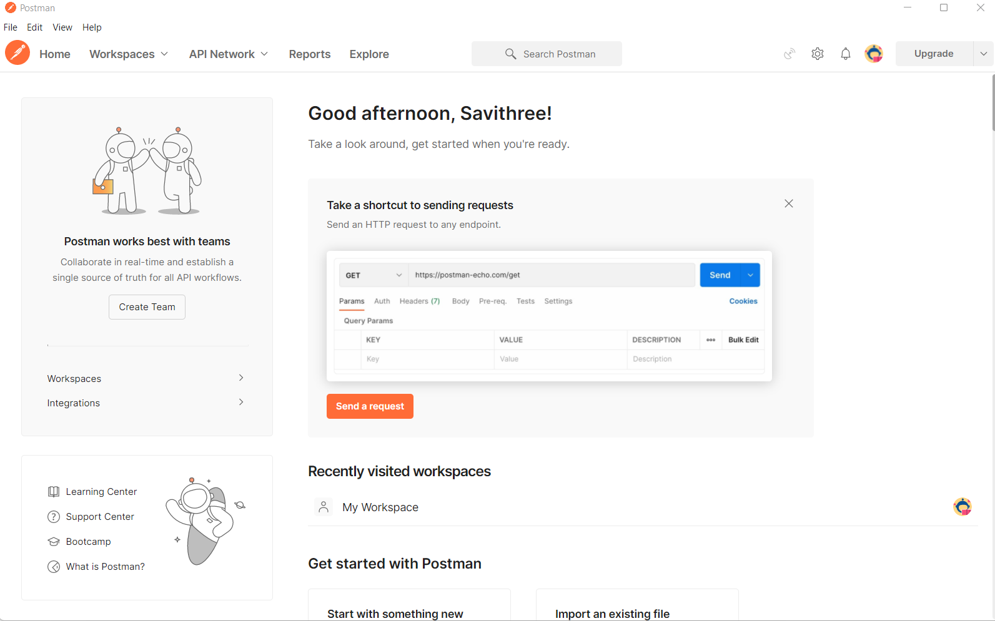
Steps to download and install
Step-6: You will see the following page, and then you are ready to use Postman.
Department of……………………………

Slide 31
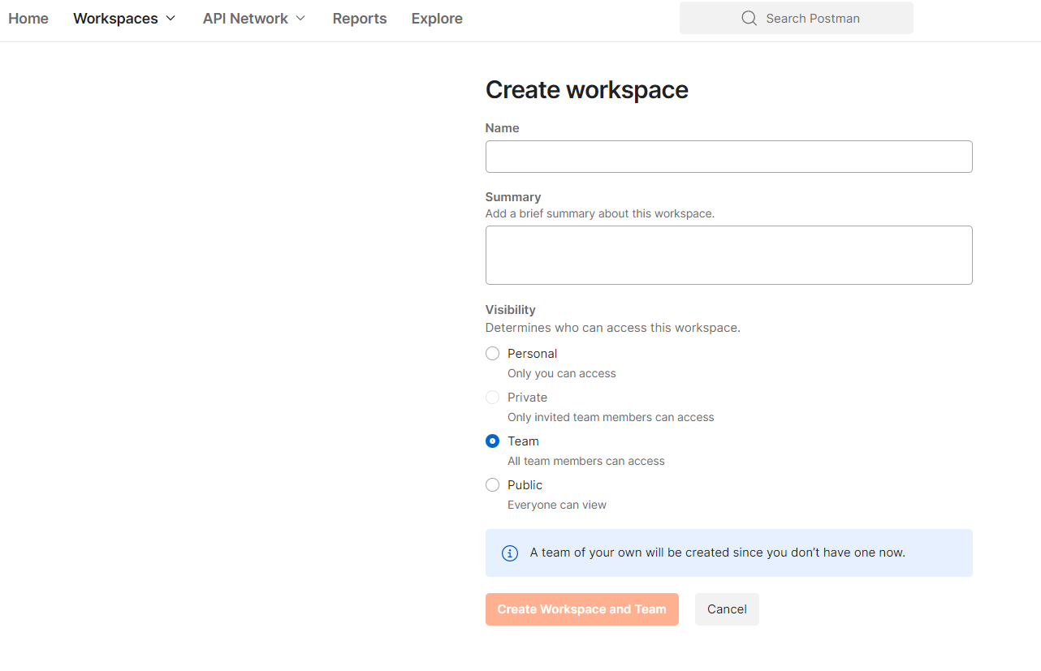
Create Workspace
In the toolbar select Workspace --→ Create workspace
Then you will see below interface
Department of……………………………

Slide 32
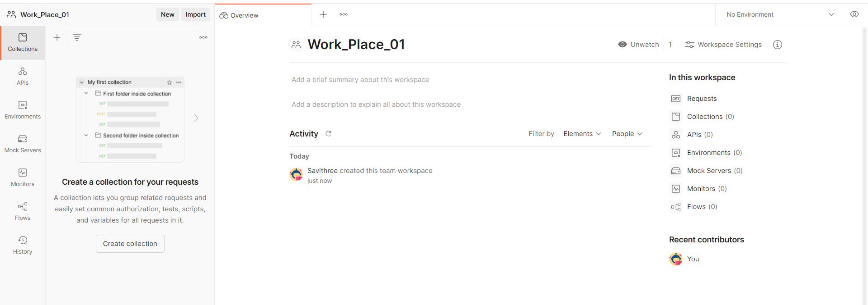
Created Workspace
Department of……………………………

Slide 33

Thank you
PO Box 21, Nawala, Nugegoda, Sri Lanka
Phone: +94 11 288 100
www.ou.ac.lk

